Slide 1

Sensation & Perception
Creativity is the ability to see relationships where none exist. Thomas Disch
And now here is my secret, a very simple secret:
It is only with the heart that one can see rightly;
what is essential is invisible to the eye.
Atoine de Saint-Exupéry

Slide 2
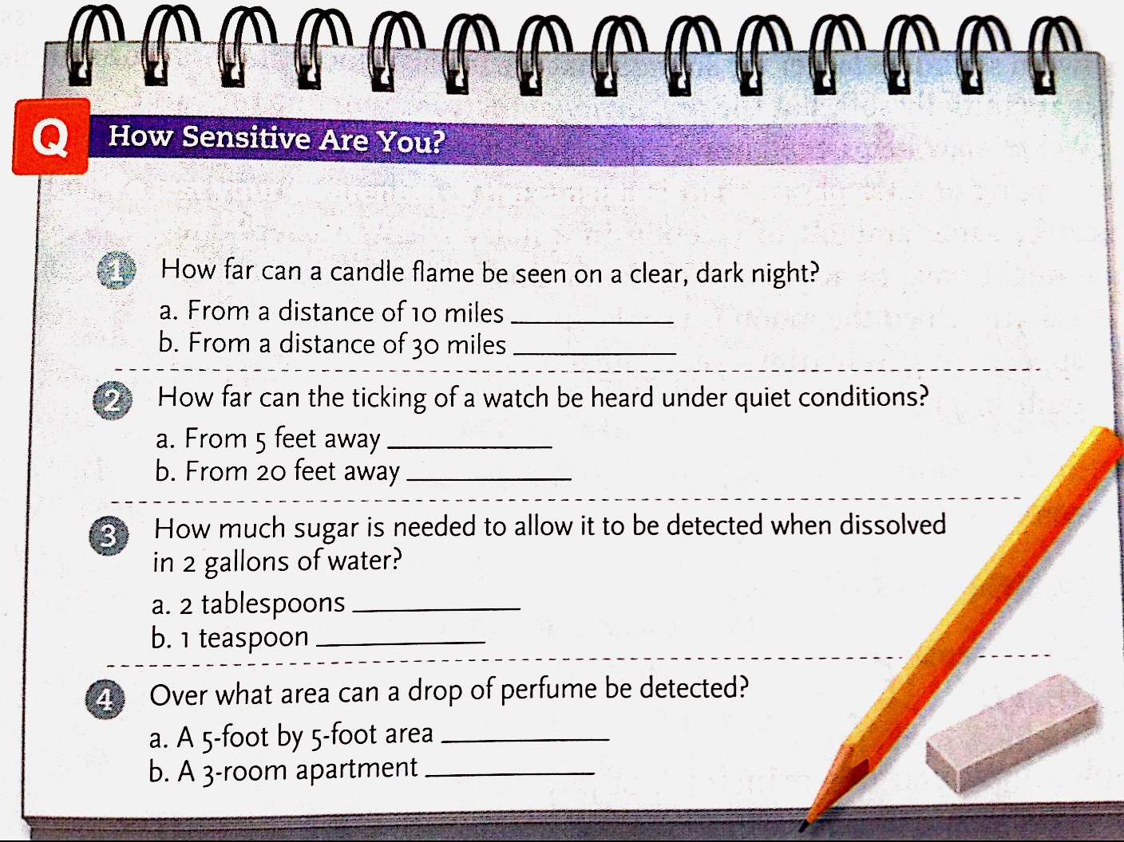

Slide 3
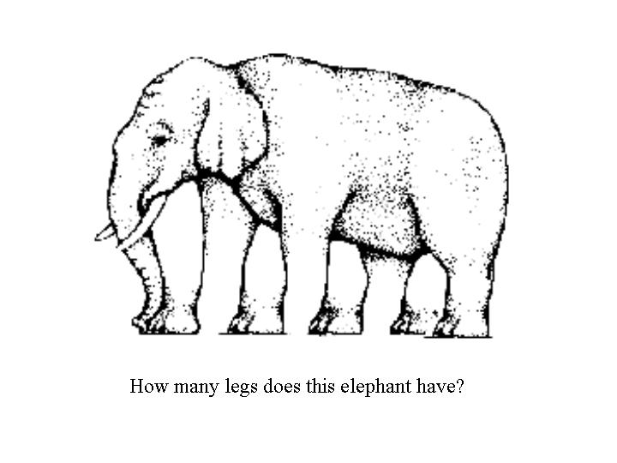

Slide 4
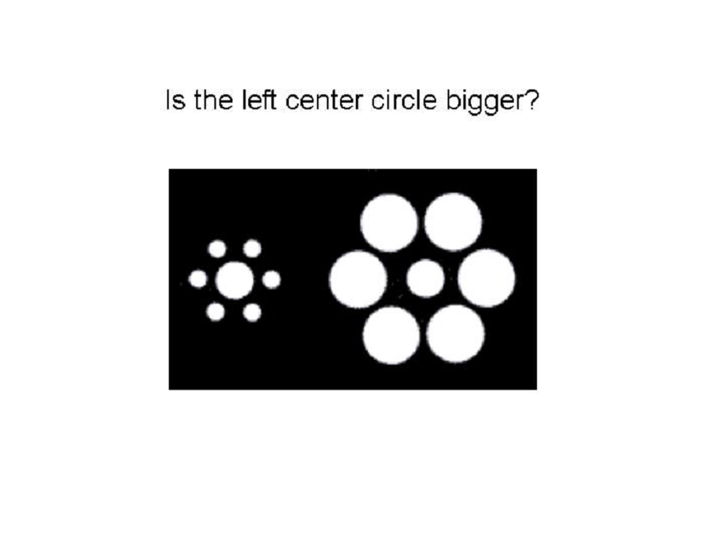
Notes:
They’re both the same!!

Slide 5
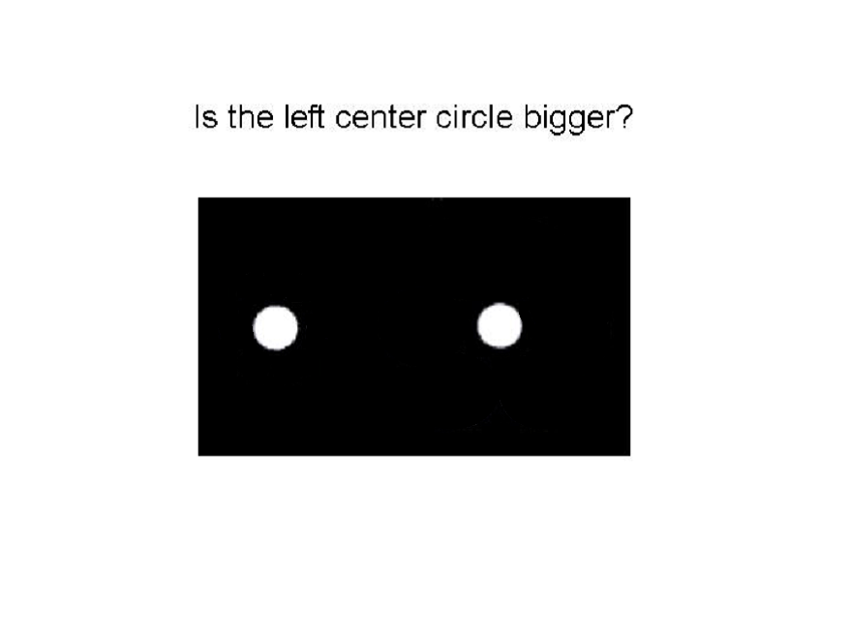

Slide 6
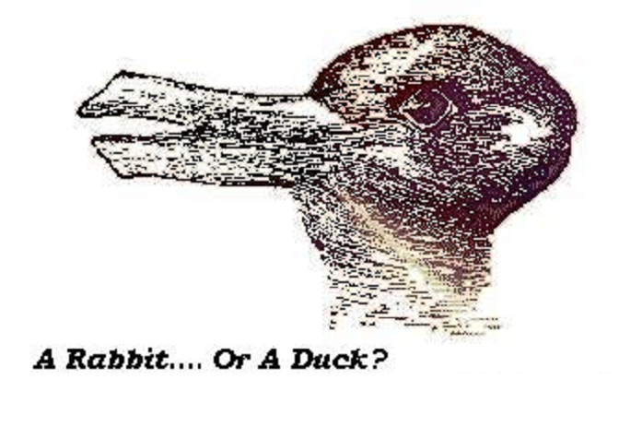
Notes:
Hint: The duck is looking left and the rabbit is looking right.

Slide 7
What’s the difference?
Sensation
  Detecting stimuli from the body or environment
Perception
  Organizing sensations into meaningful patterns
Stimulus
  Form of energy that can affect sense organs
Notes:
We’re moving now into an area of psychology that studies how we take in information about the world around us.
This chapter, sensation and perception, deals with two different facets of this phenomenon – what we decide to notice and pay attention to and then what we do with that information. While the terms get used interchangeably, sensation actually refers to the process of detecting a stimulus while perception involves using that sensory information to form a meaningful pattern. It’s the difference between noticing that there are fluctuations in the color of the screen and turning those fluctuations into letters and words.
A stimulus can be anything that attracts attention by a sensory organ.

Slide 8
Sensation
Psychophysics
  Study the relationship between stimuli & our psychological response to them
Sensory receptors
  Detect stimuli & convert energy into neural impulses
  Receptors are designed to serve very specific functions
Notes:
Psychophysics is the branch of psychology that studies the relationships between stimuli and our psychological response to them. This relationship is not a simple one-to-one relationship.
For example, have you ever set the volume on your alarm clock, thinking that it was reasonable, only to feel alarmed by the noise level of the alarm when you were awakened by it? Or have you ever started the car and had to quickly turn down the volume on the radio from where it was set last time you were in the car? The level of energy (I.e., loudness) of the radio hasn’t changed (the volume know remains in the same place as when you last had it on), but your perception of the loudness has changed drastically!
Although we can measure the physical stimulus very precisely, its effect on the observer is not so simple.
There are five major sensory receptors, which detect stimuli and, by converting energy into those action potentials we’ve talked about, create neural impulses that send messages to the brain. We’ll go over the visual system, auditory system, the skin senses, smell, and touch.

Slide 9
Sensation
Doctrine of Specific Nerve Energies
  States that different sensory modalities (vison and hearing) exist because signals received by the sense organs stimulate different nerve pathways leading to different brain areas.
Synesthesia
  Stimulation of one sense also evokes a sensation in another.

Slide 10
Thresholds and Stimulus Change
Thresholds
  There is a minimum amount of any given sensation that has to be present for us to notice it
  Absolute threshold
    This is the minimum amount of a stimulus that is necessary for us to notice it 50% of the time
Just noticeable difference (JND)
  Smallest difference in amount of stimulation that a specific sense can detect
  Weber’s law
    The size of the JND is a constant proportion of the initial stimulus
Notes:
A threshold is the minimum amount of any given stimulus that is needed for us to notice it. Beyond that, the absolute threshold is the minimum amount of any given stimulus that is needed for us to notice it half the time. Not every time, but half the time.
Our sensory systems are designed to detect novelty, contrast, and change – not sameness. After constant exposure to a stimulus, sensation fades. This decline in sensitivity is known as sensory adaptation. After a while, you simply get used to the new contact lenses in your eyes, the new watchband on your wrist, the noise level at work, or the coldness of winter. To those of you sensitive to the smells that often pervade the hallways of apartment buildings (or dorms), it is comforting to know that people also adjust to chronic odors. By adapting to a repeated stimulus, you are free to detect important changes in the environment.

Slide 11
Signal-Detection Theory
Signal-Detection Theory
  Responding to a stimulus depends on two things
    Strength of signal
    Individuals mind frame

Slide 12
Sensory Adaptation
Sensory adaptation
  If a stimulus is unchanging, we become desensitized to it
  Keeps us focused on changes, not constants
Sensory Deprivation
  The absence of normal sensory stimulation
  Heron, 1957
    Restricted vision, hearing, and touch
    Some reported within hours of discomfort and edginess. Other who stayed longer reported hallucinations
  Suefeld, 1975
    Heron used bad testing procedures (panic button, liability release)
    Found that many people enjoy deprivation, and some cognitive abilities actually improve.

Slide 13
Selective Attention
Selective Attention
  Focusing of attention on selected aspects of the environment and the blocking out of others
  Cocktail Party Effect
    Being able to change you attention from one conversation to another

Slide 14

Vision
Electromagnetic energy
  Long wavelengths: AC circuits, radio waves, infrared rays
  Short wavelengths: visible light, X-rays, UV & gamma rays
  Other animals can see other segments of the spectrum of electromagnetic energy
    Bees can see ultraviolet rays and blue-violet, but not red
    Pit vipers can see infrared rays
    Dogs can’t see all the colors that humans can (no red)
Notes:
You and I are visual creatures. How many times have you said ‘Show me.’ ‘I’ll believe it when I see it.’ ‘I saw it with my own eyes.’ ‘Out of sight, out of mind.’ Like other aspects of human anatomy, our visual system is a highly adapted product of evolution.
The eye is a highly evolved sensory receptor that has some really cool components. The eye is a concentration of cells that are sensitive to light energy. Your eye isn’t actually seeing color, but rather pulses of electromagnetic energy, which our eye then translates into experiencing color. The longer wavelengths include AC circuits, radio waves, and infrared rays. The shorter wavelengths include: visible light, UV rays, X-rays, and gamma rays. The visible light spectrum refers to only the part of the electromagnetic spectrum that humans can see. It ranges from 400 nanometers (violet) to 700 nanometers (red).
The eye is highly specialized by species such that animals are most adept at seeing those wavelengths that are most important to their survival. Humans have developed very sensitive acuity to the spectrum of wavelengths that is visible to us but other animals see other wavelengths. Bees don’t see red, but they do see ultraviolet rays and blue-violet light. This allows it to be able to better see pollen, their food source. The pit viper can see infrared rays (which humans are unable to see), which allow it to see better in the dark than its prey. Thus, it is more effective at hunting at night than its prey is at defending itself. And dogs don’t see all the colors that we see, but they do have better peripheral vision (though worse close-up vision).

Slide 15

Our Visible Spectrum
Red Orange Yellow Green Blue Indigo Violet
Hue determines color
  Depends on length of the distance from one peak to the next on the wave
Intensity determines brightness
  Depends on amplitude of the wave
Transduction
  The process where the eye converts electromagnetic energy (light) into nerve impulses
Notes:
The length of a light wave determines its hue, or perceived color. To the human eye, white light is made up of all visible wavelengths combined. Short wavelengths look bluish, medium wavelengths look greenish, and long wavelengths look reddish.
A second property of light is its intensity, or amplitude, as measured by the height of the peaks in the wave. As wavelength determines color, amplitude determines brightness. The higher the amplitude, the brighter the light appears to be.
Transduction is the process where raw energy is converted into neural signals that are sent to the brain. These signals are then selected, organized, and interpreted through the perception stage.

Slide 16
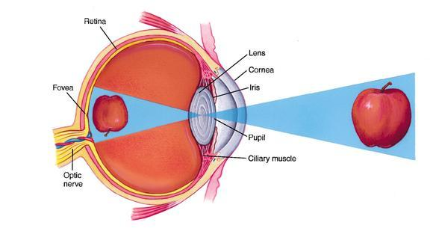
The Eye

Slide 17
Parts of the Eye
Cornea
  Light is initially focused by this transparent covering over the eye
Pupil
  Light enters the eye through this opening
Iris
  Muscle connected to the pupil that changes its size to let in more or less light
  Everyone has a unique iris (thus it is a new security technique being employed by some organizations)
Notes:
We’re now going to walk through the various parts of the eye.
Light rays from the outside world first pass through the cornea, a clear curved membrane or ‘window’. The cornea bends light so that it is sharply focused within the eye. Abnormalities in the shape of the cornea cause astigmatism.
The pupil is the small, round hole in the iris through which light passes. The iris causes the pupil to dilate (enlarge) under dim viewing conditions to let in more light and to contract (shrink) under brightness to let in less light.
Next comes the ring-shaped iris, which gives the eye its color. The iris is a muscle that is controlled by the autonomic nervous system (see, this stuff is coming back to haunt you!). Its function is to regulate the sized of the pupil.

Slide 18
Parts of the Eye
Lens
  This flexible disk under the cornea focuses light onto the back of the eye
  Accommodation
    Flexibility of the lens allows eye muscles to adjust light from objects at various distances away
Retina
  Light reflected from the lens is received by this sheet of tissue at the back of the eye
  Contains the receptors that convert light to nerve impulses
Notes:
Behind the pupil, light continues through the lens, another transparent structure whose function is to fine-tune the focusing of the light. The lens brings an image into focus through changing its shape, in a process called accommodation. Specifically, the lens becomes more rounded for focusing on nearby objects and flatter for more distant objects (the cornea, which has a fixed shape, cannot make these adjustments for different distances). With age, the lens loses much of its elasticity and keeps the flatter shape appropriate for viewing at a distance. As a result, many middle-aged people start to need glasses for reading or bifocals with a near-vision portion in the lower part of the glass.
The retina is a multi-layered screen of cells that lines the back inside surface of the eyeball. It is one of the most fascinating tissues in the body – both because of its function, which is to transform patterns of light into images that the brain can use, and because of its structure, which illustrates many basic principles of neural organization. In an odd twist of nature, the image projected on the retina is upside down. That is, light from the top part of the visual field stimulates photoreceptor cells in the bottom part of the retina and vice versa.
The retina has aptly been called an extension of the brain. It has several relatively transparent layers and contains 130 million photoreceptor cells that convert light energy into neural activity.

Slide 19
How we see color: Cones
Retinal cells that respond to particular wavelengths of light, allowing us to see color
  Most of our cones are located on the fovea, which gives us the sharpest resolution of visual stimuli
  3 types of cones, each sensitive to different light frequencies
Notes:
Cones are shorter, thicker more tapered cells that are sensitive to color under high levels of illumination. Cones are densely clustered in the center of the fovea, the pinhead-size center of the retina. Unlike the rest of the retina, the fovea contains only cones, and the ratio of rods to cones increases in the outer edges of the rods.
We have about 7 million cones. This enables us to see colors under normal lighting. Owls and other nocturnal animals don’t have any cones – they can see in night but it is only in black and white.

Slide 20
How we see in the dark: Rods
Retinal cells that are very sensitive to light but only register shades of gray (i.e., no color)
Rods are located everywhere in the retina except in the fovea
  Rods allow us to see at night without strong light – this is why we see less color at night
    Because of where the rods are on the retina, we see best at night without light in the periphery of our vision
Dark adaptation
Notes:
Rods are long, thin, cylindrical cells that are highly sensitive to light. They are concentrated in the sides of the retina and are active for black-and-white vision in dim light. Under impossibly ideal conditions, rods have the capacity to detect the light produced by one ten-billionth of a watt. On a perfectly clear, pitch-dark night, that’s like seeing the light of a match struck 30 miles away.
In chipmunks, pigeons, and other animals that are only active during the day, the retina contains no rods. Thus, they are virtually blind at night. Humans have about 120 million rods which means we can make out forms under low levels of illumination but can’t see as well at night as those animals that are nocturnal.
Often, we need to adjust to radical changes of illumination. You step into a dark movie theater after having been in the bright sunlight and you stumble around as if you were blind. After a few minutes, you can see again. This is dark adaptation: It takes about 20 minutes in darkness for your rods to kick in at full strength (though within about 30 seconds, you can see well enough to not walk right into a wall).

Slide 21
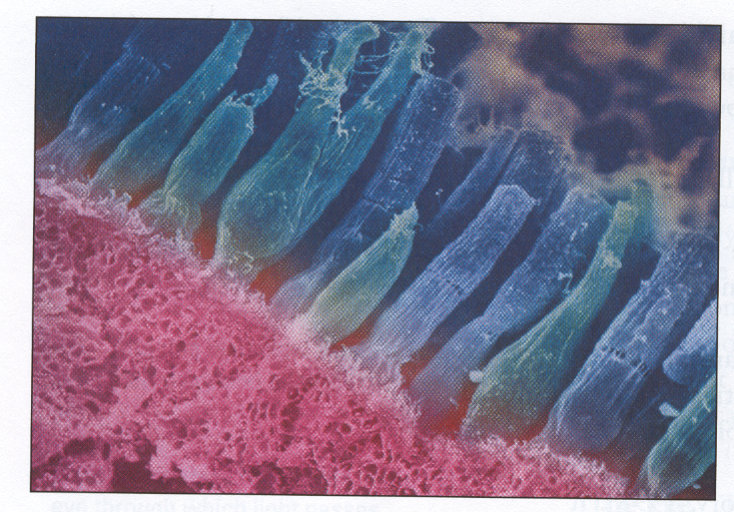
Rods & Cones
Notes:
This is a photo of rods and cones and how they are attached to the back wall of the retina. It has been magnified to 14,000 times its original size.

Slide 22
Optic Nerve
From the receptor cells in the retina, the converted impulse from light is directed to the optic nerve
  This is the large bundle of nerve fibers that carry impulses from the retina to the brain
  It sits on the retina but contains no cones or rods, so this is where you experience a ‘blind spot’
    We aren’t aware that we have a blind spot because our brain completes patterns that fall across our blind spot and because our eyes are constantly moving (‘filling’ it in)
    Pg 149 in book - an activity to demonstrate this
Notes:
The optic nerve is a pathway that carries visual information from each eyeball to the brain.
The area where the optic nerve enters the eye has no rods or cones, only axons. So each eye has a blind spot. You don’t normally notice it because your eyes are always moving, but you can find it using an exercise in your book.

Slide 23
Processing of Visual Information
Retina
  Processes electrical impulses, starts to encode and analyze sensory information (at the most basic level)
Optic Nerve
  Neurons pick up the messages from retina, transmit to the thalamus, then on to the visual cortex, then on to more specified areas
Notes:
Basically, signals from the 130 million rods and cones are funneled through a mere 1 million axons in the optic nerve. Thus, the cells are integrating and compressing signals from multiple receptors. Axon fibers of ganglion cells form the optic nerve. The messages pass along the axons of the cells, to the optic chiasm, through the thalamus, and then on to the visual cortex (which you all know is located where??? That’s right, the occipital lobe!).

Slide 24


How we see color…
Trichromatic theory
  3 types of sensors
    Red, blue & green receptors
Notes:
People think that color is an objective property of objects. In fact, it is a property of organisms. When the sunlight shines on a red rose, only the long red rays in the spectrum are reflected into our eyes. All other wavelengths are absorbed in the flower’s surface. If no wavelengths were absorbed, then the rose would appear white. Ironically, then, the rose holds everything but red. Most people can discriminate among two hundred different colors and thousands of different shades – let’s see Crayola try and do that! How do we do it? There are two major theories of color vision: the trichromatic theory and the opponent-process theory.
Early in the nineteenth century, physiologists Thomas Young and Hermann von Helmholtz (you know this guy!) argued that the human eye is receptive to three primary colors – red, blue and green – and that all other colors derived from combinations of these primaries. By recording the neural responses of individual cones to different wavelengths, 20th century researchers later confirmed the Young-Helmholtz trichromatic theory. Specifically, there are three types of cones, each having a different photochemical that produces a particular response to light. One type fires most when struck by short wavelengths, so it picks up blue. The second type is most sensitive to middle wavelengths, for the color green. The third type is most sensitive to long wavelengths, for the color red. The different combinations of cones produce other colors in the eye’s palette. Activate both red aand green cones, for example, and you will see the color yellow. Activate all three types of cones and white is produced. This, by the way, is what happens on a color TV screen, where pictures are formed from tiny red, green, and blue dots.
Now, not everybody was happy with this explanation. As German physiologist Ewald Hering saw it, yellow was a primary color, not a derivative of red and green. He also noticed that certain color combinations just don’t seem to exist. A mix of red and blue gives rise to varying shades of purple, but what is reddish green? Another puzzling phenomenon that didn’t fit was the occurrence of negative afterimages. Skip to afterimage activity.

Slide 25
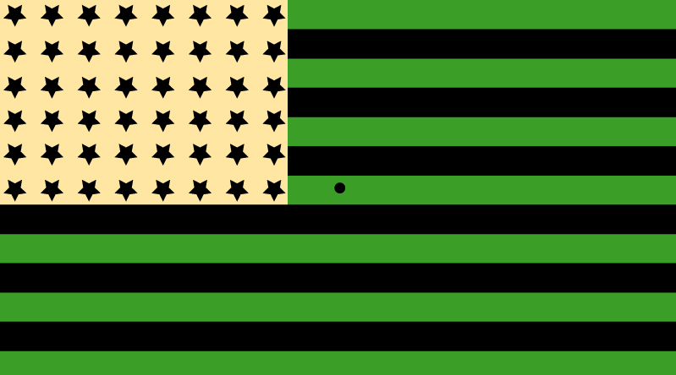

Slide 27
How we see color…
Trichromatic theory
  3 types of sensors
    Red, blue & green receptors
Opponent-process theory
  Receptors in brain respond to pairs of colors
    White-black / red-green / yellow-blue
Which is correct?
  Both!
Notes:
An afterimage is a sensation that persists after prolonged exposure to a stimulus. What did you see before? In situations such as this one, staring at a green image leaves a red afterimage, yellow leaves a trace of blue and black leaves white.
Putting the pieces together, Hering proposed the opponent-process theory of color vision. According to this theory, there are three types of visual receptors, and each is sensitive to a pair of complementary or opponent colors. One type reacts to the colors blue and yellow, a second type detects red and green, and a third type detects variations in brightness ranging from black to white. Within each pair of red-green, blue-yellow, and black-white receptors, some parts fire more to one color whereas other parts react to its opposite. That’s why we never see bluish yellow or reddish green but we might see bluish green and reddish yellow. While seeing one color at a specific spot on the retina, you cannot also see its opposite color on the same spot.
Trichromatic theory argues that the eye has three kinds of color sensors (cones), with each sensor responding maximally to a distinct range of wavelength. Color vision arises from the combinations of neural impulses from these three different kinds of sensors. A lot of researchers believe that the corresponding wavelengths here map onto blue, green, and red. For example, in presenting a yellow (580 nm) stimulus to a participant, you would most likely see a large amount of firing of the green (530 nm) and red (650 nm) cones, with little to no firing of the blue (460 nm) cones.
Other researchers argued that some color combinations don’t make sense – red and green mixed together don’t make yellow; it looks more like mud. But, in addition to the fact that mixing physical colors before the wavelengths get to the retina is a different process than the cones firing when the resulting wavelength reaches the retina, sensing color on the retina from various wavelengths then gets sent to the brain for perception via opponent-process cells in the brain. Thus, the opponent-process theory was offered as a complimentary theory to the trichromatic theory. This theory states that if a color is present, it causes cells that register it to inhibit the perception of an opposing color.
The opponent-process theory proposes six psychologically primary colors, which are assigned by pairs to three kinds of receptors: white-black receptors, red-green receptors, and yellow-blue receptors. If white is present, then the perception of black is inhibited, if red is present then green is inhibited, and if yellow is present then blue is inhibited.
Inhibitions, along with various mixtures of these primary light wavelengths, more readily explain the complex range of colors that we experience after sensations of colors are sent from the retina to the brain’s opponent-process receptor cells.
To clarify:
Trichromatic theory and opponent-process theory work at two different levels, specifying different receptor cells at different stages in the process.
When you are looking at black words on a white page, you see both black and white because you are stimulating many white-black receptors on your retina. You see a black letter with one white-black receptor (and doing so inhibits seeing white in that particular receptor) and you see the background white with other white-black receptors (and doing so inhibits seeing black in those particular receptors).

Slide 28
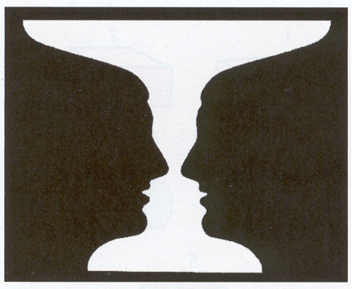
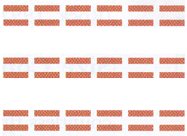
Gestalt Principles of Vision
Figure-ground
  We recognize figures (objects) by distinguishing them from the background
Proximity
  Marks that are near one another tend to be grouped together
Notes:
Okay, so sensory intake of visual stimuli must be processed by the brain into organized structures (the perception side of the equation). We don’t see just random splashes of color, unless you’re looking at a Jackson Pollack, you see organized structures that have shape and meaning.
The eye by itself cannot organize visual input into shapes that correspond to objects – that’s the brain’s job!
There are some Gestalt principles that help organize this process, and are common concepts for us to rely on as we are organizing this information.
The figure-ground principle is that people automatically focus on some objects in the perceptual field to the exclusion of others. What we focus on is called the figure. Everything else fades into the ground. So, a teacher standing in front of a blackboard, the printed black words on a page, the lights on the car coming at us on a dark highway, a scream in the night, and the lead signer’s voice in a rock band are all common figures and grounds. Gestalt psychologists are quick to point out that these perceptions are in the eyes (or ears) of the beholder – but that we are also prone to ‘figurize’ objects that are close to us, novel, intense, loud, and moving rather than still. But as the image at the bottom of the page shows, we are mentally capable of flip-flopping the figure-ground perspective.
The proximity principle holds that the closer objects are to another, the more likely they are to be perceived as a unit. The lines at the bottom of the page are more likely to be perceived as rows rather than as columns because they are nearer to one another horizontally than vertically.

Slide 29
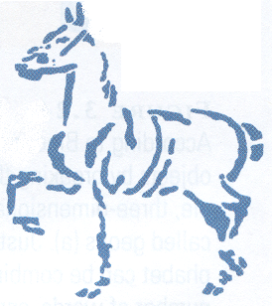
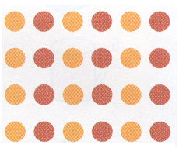
Gestalt Principles of Vision
Closure
  We tend to fill in gaps in a figure
Similarity
  Marks that look alike tend to be grouped together
Notes:
The closure principle holds that where there are gaps in a pattern that resembles a familiar form, people mentally ‘close’ the gaps and perceive the object as whole. This tendency enables us to recognize imperfect representations in hand drawings, written material, and so on.
The similarity principle holds that objects that are similar in shape, size, color, or any other feature tend to be grouped together. So the dots form perceptual columns rather than rows because of the similarities in color.

Slide 30
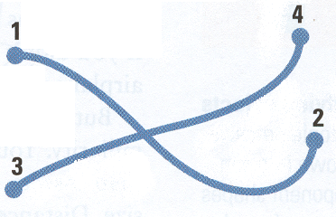
Gestalt Principles of Vision
Continuity
  Marks that tend to fall along a smooth curve or a straight line tend to be grouped together
Notes:
The continuity principle holds that people perceive the contours of straight and curved lines as continuous flowing patterns. In this figure, we see points 1 and 2 as belonging to one line and points 3 and 4 as belonging to a second line. The same pattern could be seen as to V shapes, but instead we perceive two smooth lines that form a cross in the center.

Slide 31
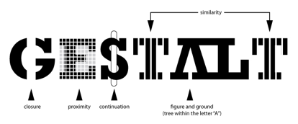

Slide 32
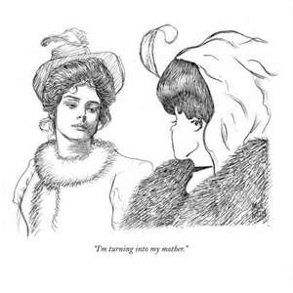

Slide 33


Slide 34
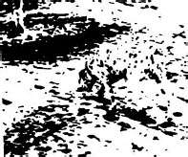

Slide 35
Depth Perception
How is it that we perceive a 3-dimensional world when our eyes only project a 2-dimensional image on our retinas??!
Our brain uses different cues to perceive depth
Binocular Cues
Monocular Cues
  Binocular disparity
    Since we use both our eyes to focus on an image, the angles used by each eye to put the image on the fovea of our retina is used by the brain to perceive distance
Notes:
So how do we know that objects in three-dimensional space have depth, and how do we perceive distance when images projected on each retina are flat and only two-dimensional? There are two types of information that are used in depth perception: binocular cues and monocular cues.
The main binocular cue is that of binocular disparity. With our eyes being set about 2 ½ inches away from each other, each retina receives a slightly different image of the world.
To demonstrate, hold your finger about 4 inches from your nose and shut your right eye. Then shut only your left eye and look at the finger. Right. Left. As you switch back and forth, you’ll see that each eye picks up the image from a slightly different vantage point. If you hold your finger farther away and repeat this performance, you’ll notice that there is less image shifting.
The reason: Binocular disparity decreases with distance. Special neurons located in the visual cortex use this retinal information to calculate depth, distance, and dimensionality.
You’ve probably all seen those posters that have the stereogram images where if you stare at them long enough, you can see a 3-D image ‘pop’ out. There are ways to alter images so that a 2-D image becomes 3-D…this was discovered in the 1800s and has led to the development of virtual reality technology.

Slide 36
Depth Perception
Monocular cues
  Our brain also uses information from the stimulus that does not involve our use of both eyes
  Motion
    Specifies distance of an object based on its movement
    Motion parallax
  Texture gradient
    Progressive changes in surface texture that signal distance
  Linear perspective
    Parallel objects seem to get closer together as they get farther away
Notes:
There are cues within the stimulus itself that provide clues to our brain about depth perception, which don’t rely on the use of both our eyes.
For example, the motion of a stimulus can specify the distance of the stimulus. There is a phenomenon known as motion parallax where as we move, objects that are actually standing still appear to move. If you’ve ever stared out the window of a car as you travel down the highway, you notice that closer objects that you are not focusing on seem to whiz right past you while farther away objects that you focus on seem to move in the same direction as you. Objects at different distances also appear to move at different speeds. There is another motion-based illusion known as illusory reverse-motion where if you are in a stable object (say a car) another object to the side (say another car in the next lane over) moves forward, you may actually have a perception that you are moving backward. I drive a manual transmission car and so don’t always need to have my foot on the brake to stay in one spot…needless to say, when this has happened to me, I immediately throw my foot on the brake only to realize that I wasn’t moving at all!!
We can also get cues from a stimulus based on its texture gradient. These are progressive changes in the texture of the object that signal changes in distance. As a collection of objects recedes into the horizon, they appear to be spaced more closely together, which makes the surface texture appear to become denser.
The last monocular cue that we are going to discuss is that of linear perspective. With distance, the parallel contours of highways, rivers, railroad tracks, and other row-like structures perceptually converge – and eventually they reach a vanishing point. The more the lines converge, the greater the perceived distance.

Slide 37
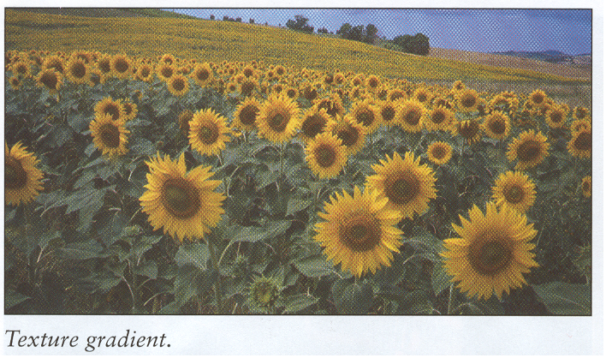
Texture Gradient

Slide 38
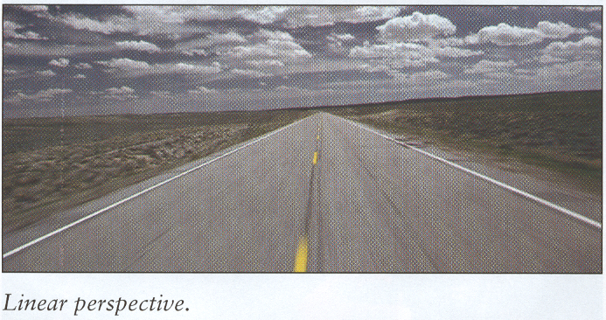
Linear Perspective

Slide 39
Perceptual Constancy - Vision
The image of an object on your retina can very in size, shape, and brightness
  But we still continue to perceive the object as stable in size, shape and brightness
Size constancy
  The tendency to view an object as constant in size despite changes in the size of its image on the retina (as we move)
Shape constancy
  The tendency to see an object as retaining its form despite changes in orientation
Notes:
Size constancy: If you see a car from a block away, you still perceive its size not to change even though the image is smaller on your retina compared to a car parked right next to you.
Shape constancy: You perceive a book to maintain its rectangular shape even though at the different angles, your retinal image of the book is not a rectangle.

Slide 40

Size Constancy

Slide 41

Auditory System
If a tree falls in the forest with no one around, does it still make a sound?
  No! Sound is the perception (i.e., transduction) of moving air waves
Pitch
  Frequency of air waves
Loudness/volume
  Amplitude of air waves
Notes:
Now that we have a very complete understanding of the visual system (one of our more complex senses), let’s move on to the auditory system. We start off with the eternal riddle: If a tree falls in the forest with no one around, does it still make a sound? The answer is NO! Sound is the perception (from the system of transduction) of moving air waves. That falling tree will move air waves but sound is only the perception of those changes so you have to have someone there to perceive the changes.
Pitch refers to the frequency of the air waves and determines a tone’s highness or lowness. The loudness or volume of a tone is determined by the amplitude of the waves (the size of the peak from one wave to the trough of the next).

Slide 42
Auditory System
The Ear
  Outer ear
    Pinna & external auditory canal
  Middle ear
    Eardrum (tympanic membrane), hammer, anvil & stirrup
  Inner ear
    Oval window, cochlea (basilar membrane inside)
Notes:
The hammer, anvil, and stirrup are the three smallest bones in the human body.
Sound waves are collected in the outer ear, beginning with the fleshy pinna. Some animals, such as dogs, cats, and deer, can wiggle this structure like a radar dish to maximize the reception of sound (humans cannot). Research shows that the folds of the pinna enable people to pinpoint the location of sounds – for example, whether they come from above us or below, in front or behind.
The sound waves are then funneled through the auditory canal to the eardrum, a tightly stretched membrane that separates the outer and middle portions of the ear.
The eardrum vibrates back and forth to the waves, thereby setting into motion a series of tiny connect bones in the middle ear – the hammer, the anvil, and the stirrup (which happen to be the smallest bones in the body). This middle-ear activity amplifies sound by a factor of thirty. The last of these bones, the stirrup, then vibrates against a soft inner-ear membrane called the oval window.
This vibration is transmitted to the fluid that fills the canals of the cochlea, a snail-shaped tube – and the resulting motion presses up against the basilar membrane, which brushes up against an array of 16,000 sensitive hair cells. These hair cells bend, exciting fibers in the auditory nerve – a bundle of axons that link to the auditory centers of the brain.

Slide 43
Auditory System - Hearing
The process of hearing
  Air waves move the tympanic membrane (eardrum), which moves the hammer, anvil and stirrup (these all amplify the air wave and pass it on)….
  …to the basilar membrane in the cochlea
    Here, different frequencies are transduced via hair cells (i.e., the rods and cones of the ear) into nerve impulses that are sent to the auditory cortex of the brain

Slide 44
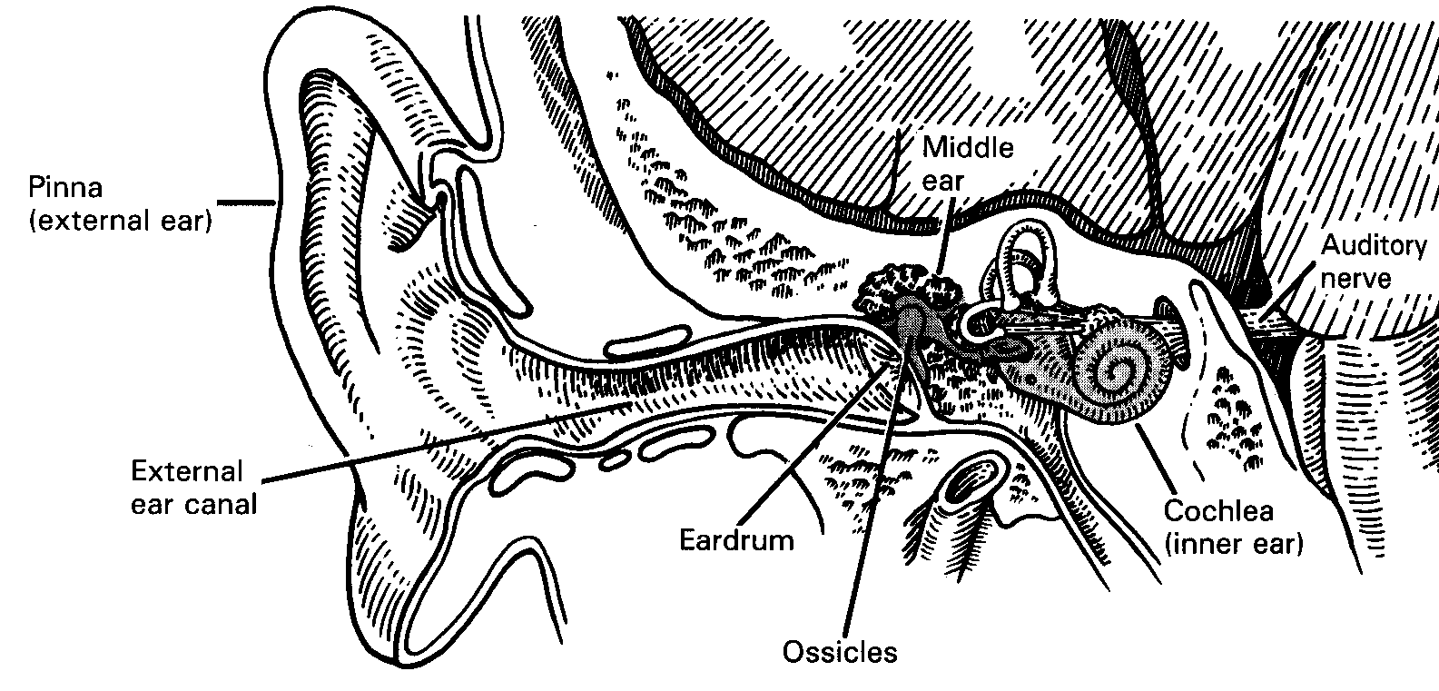
The Outer Ear

Slide 45
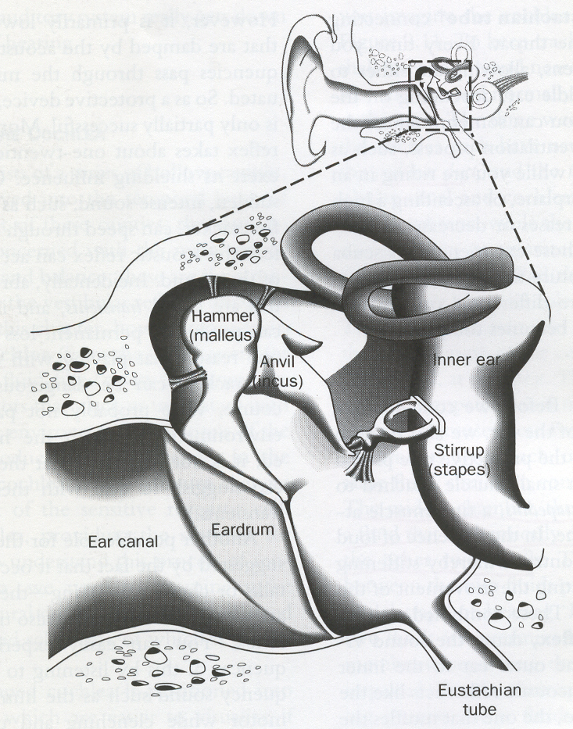
The Middle Ear

Slide 46
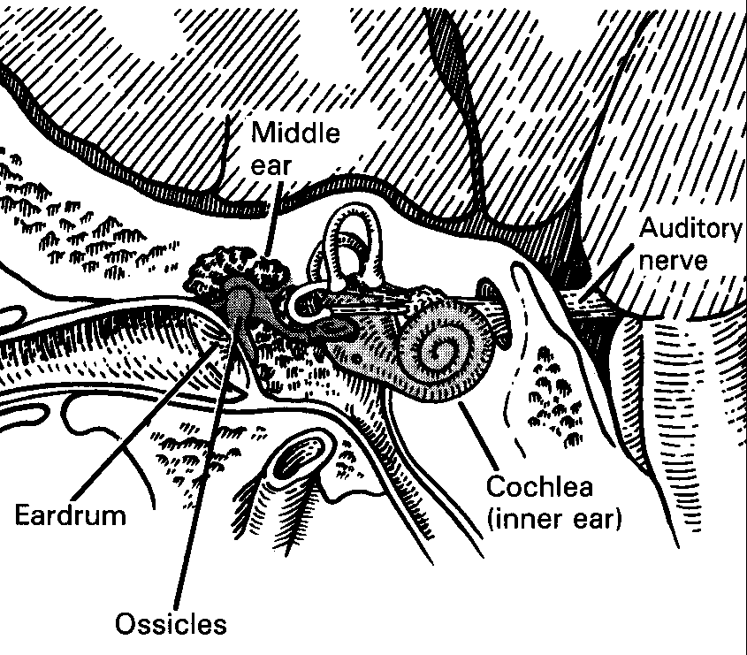
The Inner Ear

Slide 47
Theories on hearing
Two theories on transduction in basilar membrane (i.e., how we perceive sound)
  Frequency Theory
    Neural impulses are stimulated more with higher frequencies of air waves
    More plausible for small frequencies, rather than high frequencies because we can hear freqs higher than the maximum rate of neural firing (1,000 neurons a second)
  Place Theory
    Different frequencies of air waves activate different places along the basilar membrane
Notes:
The Frequency Theory functions on the belief that pitch depends on the rate, not place, of response and that neurons can fire in synch with signals (the sound waves). Thus the rate of response might represent frequency of stimulus (the frequency of the sound waves). But, we can hear frequencies that are at higher rates than our neurons can fire. Thus, this theory may only explain the hearing process for lower frequencies.
The Place Theory of hearing works on the belief that different frequencies of air waves activate different places along the basilar membrane. Under this framework, higher frequencies (which get most of the space) are perceived at the base of the cochlea (at the oval window) while lower frequencies are perceived at the upper portion of the cochlea. Here, higher frequencies get about 2/3 of the space while lower frequencies get about 1/3 of the space. Again, since the focus in this theory is on higher frequencies, this may account for how we hear high frequencies and frequency theory might explain how we hear lower frequencies.

Slide 48

Gustation (Taste)
Detects molecules of substances that have dissolved in saliva
Tongue has Papillee
  Knoblike structures containing taste buds
Taste buds
  Clusters of hair-like receptor cells
    Within each bud is a cluster of 50 to 150 receptor cells
  We have about 10,000 (most on tongue)
  Four types: sweet, sour, salty & bitter
  A fifth is now considered to be Umami
Notes:
Children have more taste buds than adults. Some people have more taste buds than others.

Slide 49
Sweet
Sweetness, usually regarded as a pleasurable sensation, is produced by the presence of sugars and a few other substances
Examples: Sugar, Sweetened Chocolate

Slide 50
Sour
The sour taste comes from higher acidic food
Examples: Citrus, which includes lemons or limes

Slide 51
Salty
Saltiness is a taste produced primarily by the presence of sodium ions.
Examples: Salt

Slide 52
Bitter
The bitter taste comes from those foods with stronger, more earthy flavors
Examples: leafy green vegetables, coffees, teas and spices like turmeric

Slide 53
Umami
Umami is an appetitive taste and is described as a savory or meaty taste
A loanword from Japanese meaning "good flavor" or "good taste"
Examples: Beef, Cheese, and Soy Sauce

Slide 54
Gustation (Taste)
The sense of taste combines with the sense of smell to produce perception of flavor of food
  Research suggests that neural impulses for both senses converge to some degree in brain area associated with the perception of flavor
  When the sense of smell is blocked, we have a harder time detecting most flavors
Notes:
If you’ve ever been sick with a head cold, you’ve probably also experienced a loss of appetite. Part of that loss of appetite is due to an inhibited sense of smell. Research shows that when our sense of smell is blocked, we have a harder time detecting most flavors through taste.
If you slice an apple and an onion into small cubes, hold your nose, and conduct a blind taste test, you’ll have trouble telling the two foods apart.

Slide 55

Olfaction (Smell)
Olfaction
  Detects molecules in the air
Lock-and-key
  Olfactory receptors (i.e., the locks) are built so that only molecules (the keys) with particular shapes will fit in particular receptors
  Receptors send neural signals to the brain, passing the thalamus (memory) and the limbic system (emotions) along the way
    This is why odors often trigger emotional memories
Notes:
We have between 5 and 10 million olfactory receptors…dogs have about 200 million.
All smells have a chemical origin. Depending on their molecular structure, substances emit odor-causing molecules into the air. Some objects like glass and metal have no odor. Others, like that of cherry pie, have very strong odors. We inhale these airborne odorant molecules – which dissolve and become trapped by olfactory receptors in the moist yellow lining of the upper nasal passages just above the roof of the mouth. Certain molecules seem to fit certain types of receptors the way a key fits a lock. Once activated, they trigger an action potential in the olfactory nerve. This nerve connects the nose to the olfactory bulb, a bean-size organ that distributes information throughout the cortex.
Smells tend to cause emotional reactions because they pass through the lymbic system.

Slide 56

Skin Senses
Touch
  Skin is the body’s largest sensory organ
  Millions of skin receptors mix and match to produce specific perception
  Four basic types of sensations
    Pressure, warmth, cold, and pain
Notes:
Every organism has a sense of touch. Sea snail withdraw their gills at the slightest pressure. Spongers sense an intruder by feeling the water around them quiver. As for us humans, feeling is often believing. Put up a ‘wet paint’ sign and you’ll find, paradoxically, that it seems to invite touch rather than inhibit it. Tactile sensations are unique in many ways. To begin with, touch is the only sensation with receptors that are not localized in a single region of the body. We need eyes to see, ears to hear, a nose to smell, and a tongue to taste. But the organ of touch, and site of its sensory receptors, is skin.
Skin is by far the largest organ of the body. It covers 2 square yards and weights 6 to 10 pounds. It is multilayered, waterproof, elastic (though that has limits), and filled with hair follicles, sweat-gland ducts, and nerve endings that connect to the central nervous system. When you consider all the sensations that emanate from your skin – feeling hot, cold, wet, dry, sore, ,itchy, scratchy, sticky, gooey, greasy, tingly, numb, and hurt – you can see that touch involves not one sensory system but many.
Most psychologists agree that the sense of touch consists of four basic types of sensations: pressure, warmth, cold, and pain. Researchers initially thought that there was a separate receptor in the skin for each of these four sensations, but it now appears that only pressure sensations have unique and specialized nerve endings dispersed throughout the body. Our most sensitive areas (to pressure) are the hands, fingers, and face (calves, thighs, and arms are the least sensitive) but each one has its own threshold. In all cases, pressure causes nerve endings to fire messages through the spinal cord, brainstem, and thalamus en route to the somatosensory cortex.
Normal human body temperature is 98.6 degrees Fahrenheit, or 37 degrees Celsius. There are two striking facts about the sensation of temperature. First is that it is, to a large extent, relative to your current state. WATER DEMONSTRATION
The second fact about temperature is that there are two separate sensory systems – one for signaling warmth, the other for signaling cold. Early studies showed that some spots on the skin respond more to warming and others more to cooling. ‘Hot’ is a particularly intriguing sensation in that it is triggered when these warm and cold spots are simultaneously stimulated. Thus, when people grasp two braided pipes – one with cold water running through it, the other with warm water – they will pull away, complaining that the device is literally too hot to handle. This effect of the ‘thermal grille’ is found not only among humans but also in other animals. Apparently, the brain interprets the dual firing of both types of temperature receptors as being caused by a burning hot stimulus. Is the sensation a mere illusion? No. PET and other imaging studies show that gripping the entire grill (but not the warm or cold bars alone) activates regions of the brain that are responsive to pain.

Slide 57

Skin Senses
Temperature
  Two separate sensory systems – one for signaling warmth and the other for signaling cold
  Also have distinct spots on the skin that register only warmth or cold
    If you activate both at the same time, the person perceives ‘hot’!

Slide 58

Skin Senses
Pain
  Pain serves a function – it warns
  us of impending danger
  Endorphins
    Neurotransmitters in the brain that have a pain-killing effect
  Gate-control theory
    Pain impulses can be inhibited by closing of neural gates in the spinal cord
Notes:
Whatever the source, people are understandably motivated to avoid and escape from pain. Yet pain is crucial to survival because it serves as a red flag, a warning system that signals danger and the risk of tissue damage. Life without pain may sound great, but it would be a life that is not likely to last very long and one that is filled with cuts, scrapes, burns, and scars.
Pain is a subjective, emotionally charged sensation. No single stimulus triggers pain the way that light does vision, no nerve endings in the skin are specially dedicated to pain over other sensations, and people with similar injuries often experience different degrees of pain. Clearly, the conditions that lead us to report pain include not only the threat of bodily harm but also culture, religion, personality, expectations, and other factors.
Endorphins are the neurotransmitter that is responsible for dulling pain.
They kick in based on the gate-control theory of pain. According to this theory, the nervous system can process only a limited number of sensory signals at once. When the system is full, a neural ‘gate’ in the spinal cord either blocks or allows the upward passage of additional signals to the brain 9the gate is not an actual structure but a pattern of inhibitory neural activity). Thus, you can partially shut the gate on pain by creating competing sensations. This is the old – you’ve got a headache and your dad offers to get rid of it. He asks for your hand, which trusting him, you hold out, and he hits your thumb on the table…your headache is gone since a new sensation of pain is being experienced. Of if you fall and hurt your knee, rubbing it hard will send new impulses into the spinal cord – and inhibit other pain signals. That’s while it helps to put ice on a scrape or to scratch a mosquito itch. For chronic pain, deep massage or acupuncture may provide similar benefits.

Slide 59

Body Senses
Kinesthetic sense
  Provides info about position of joints, muscles, limbs
    Gives us control over body movements
Vestibular sense
  Provides info about body’s orientation relative to gravity and head’s position in space
    Helps us maintain balance
    Relies on semicircular canals in the inner ear
Notes:
Kinesthetic sense example: when you close your eyes, you can touch your nose (if you’re not too drunk…)
Vestibular sense: If you have an earache that affects these canals, you will have a tough time keeping your balance.

